Slide 1
Group 13, the Boron Family

Slide 2
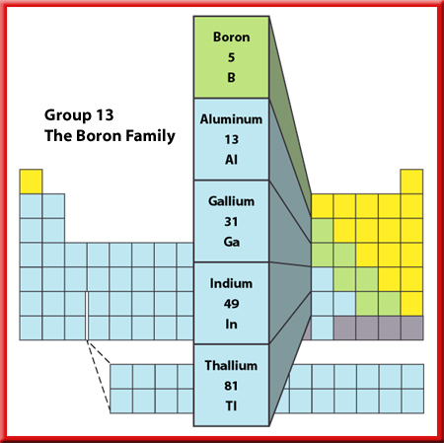
Representative Elements
Groups 13 through 18
The elements in Groups 13-18 are not all solid metals like the elements of Groups 1 and 2. In
fact, a single group can contain metals, nonmetals, and metalloids and have members that are solids, liquids, and gases.

Slide 3
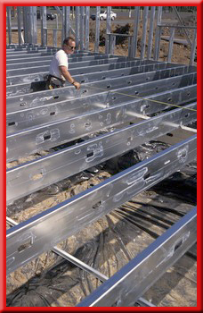
Representative Elements
Group 13—The Boron Family
The elements in Group 13 are all metals except boron, which is a brittle, black metalloid.
Cookware made with boron can be moved directly from the refrigerator into the oven without cracking.

Slide 4
Representative Elements
Group 13—The Boron Family
Aluminum is used to make soft-drink cans, cookware, siding for homes, and baseball bats.
Gallium is a solid metal, but its melting point is so low that it will melt in your hand.
It is used to make computer chips.

Slide 5
This powerpoint was kindly donated to www.worldofteaching.com
http://www.worldofteaching.com is home to over a thousand powerpoints submitted by teachers. This is a completely free site and requires no registration. Please visit and I hope it will help in your teaching.

